Slide 1

Background Removal 진행 상황 보고
개발 인턴 김경태

Slide 2
Parameter – Pymatting
Pymatting + PointRend 값 조정 및 향상
value = 1e-3 alpha = estimate_alpha_cf(image, trimap, laplacian_kwargs={"epsilon": value},
cg_kwargs= {"maxiter":3000})
value2 = 0.5~0.7 foreground= estimate_foreground_ml(image, alpha, regularization = value2)

Slide 3
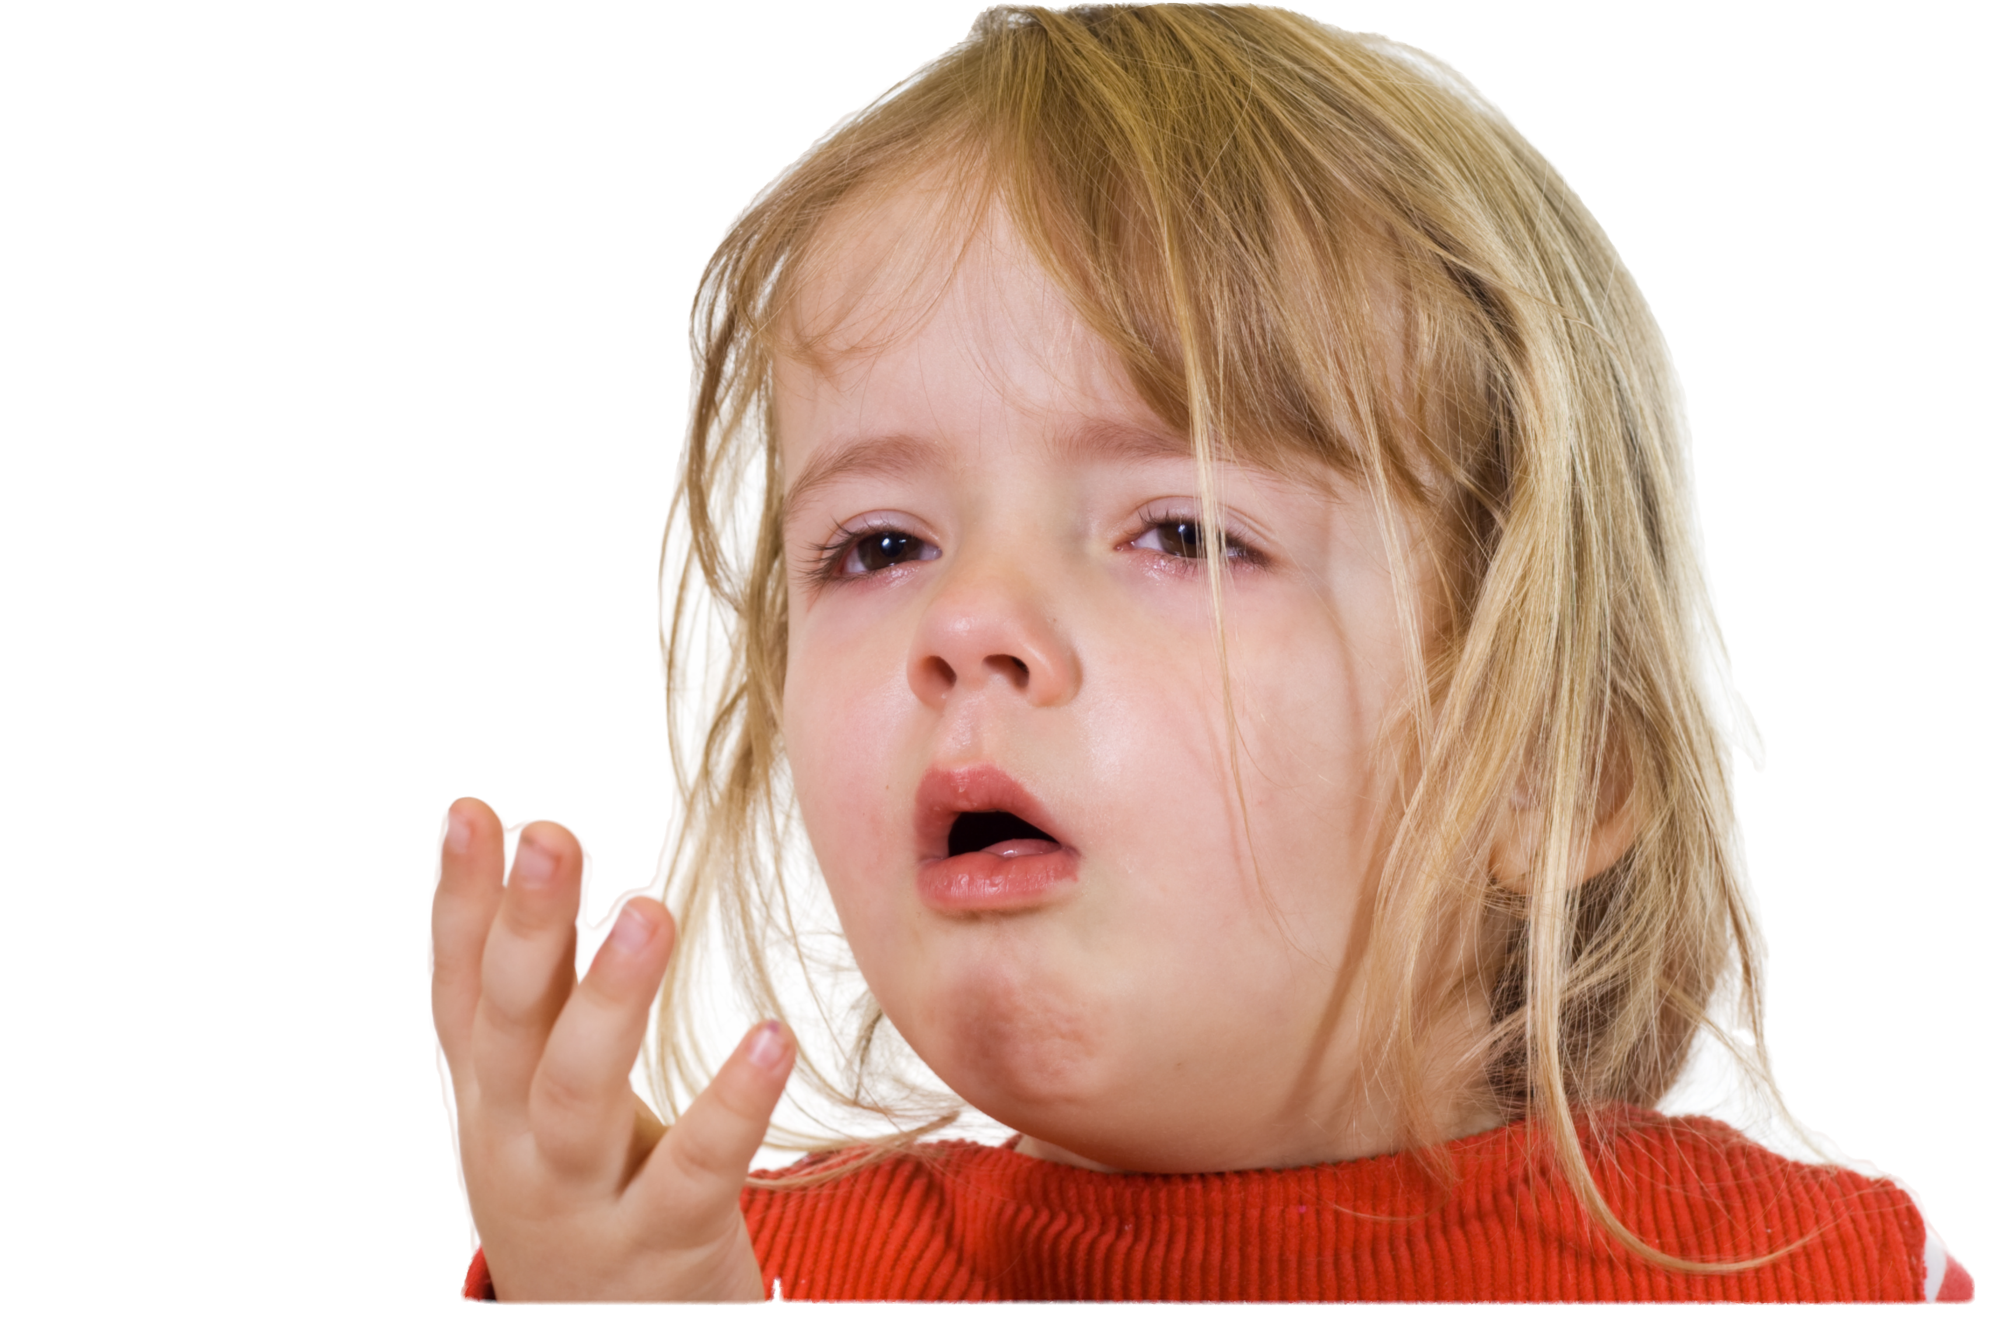
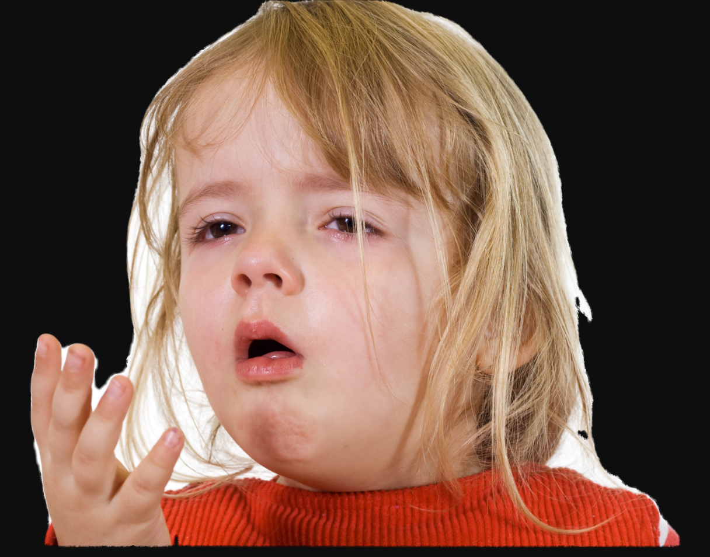
Hair matting

Slide 4
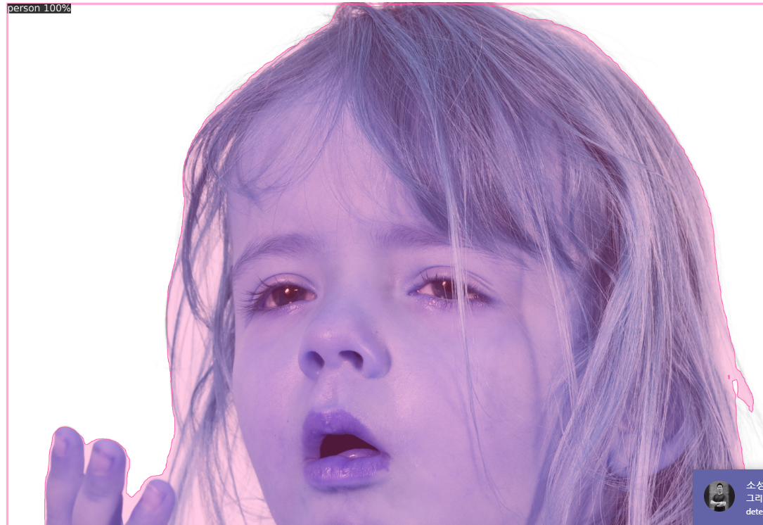
Hair matting

Slide 5
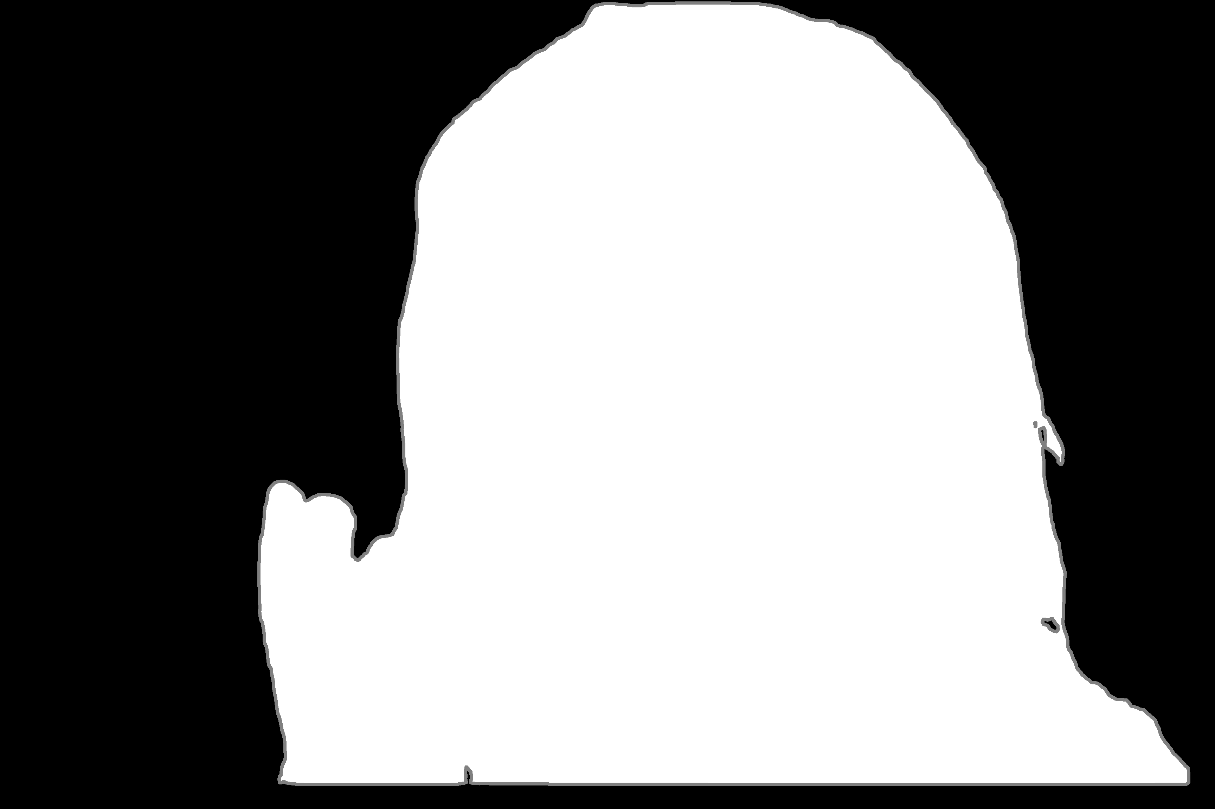
Hair matting

Slide 6
Hair matting

Slide 7
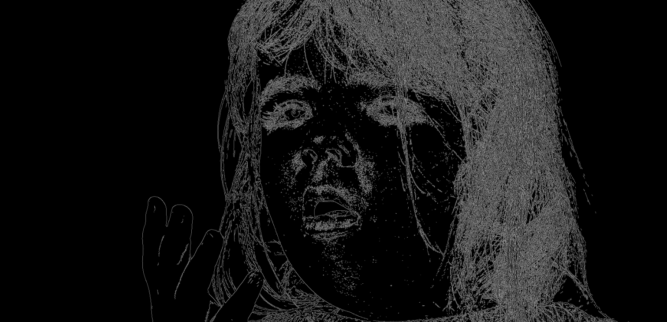
Hair matting
Canny - Opencv edge detection

Slide 8
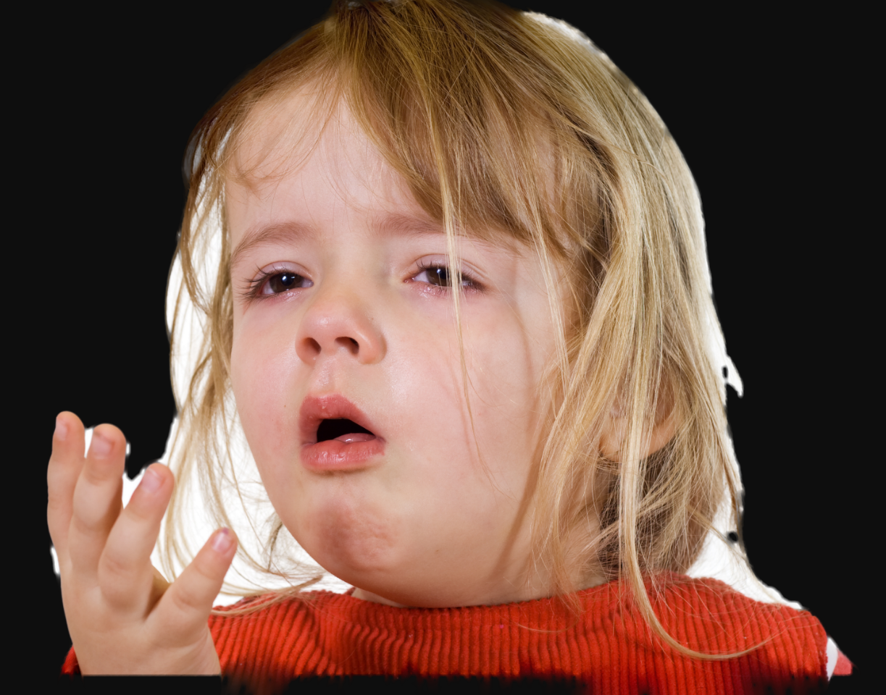
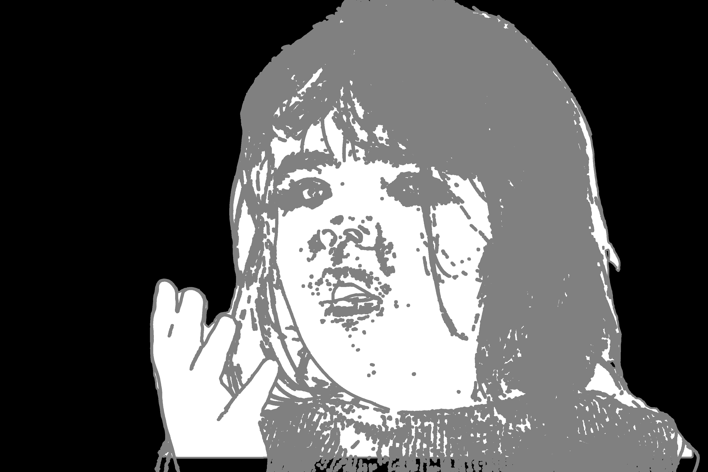
Hair matting
Combining original trimap with image made by Canny
Canny threshold ( min = 60, max = 120 )

Slide 9
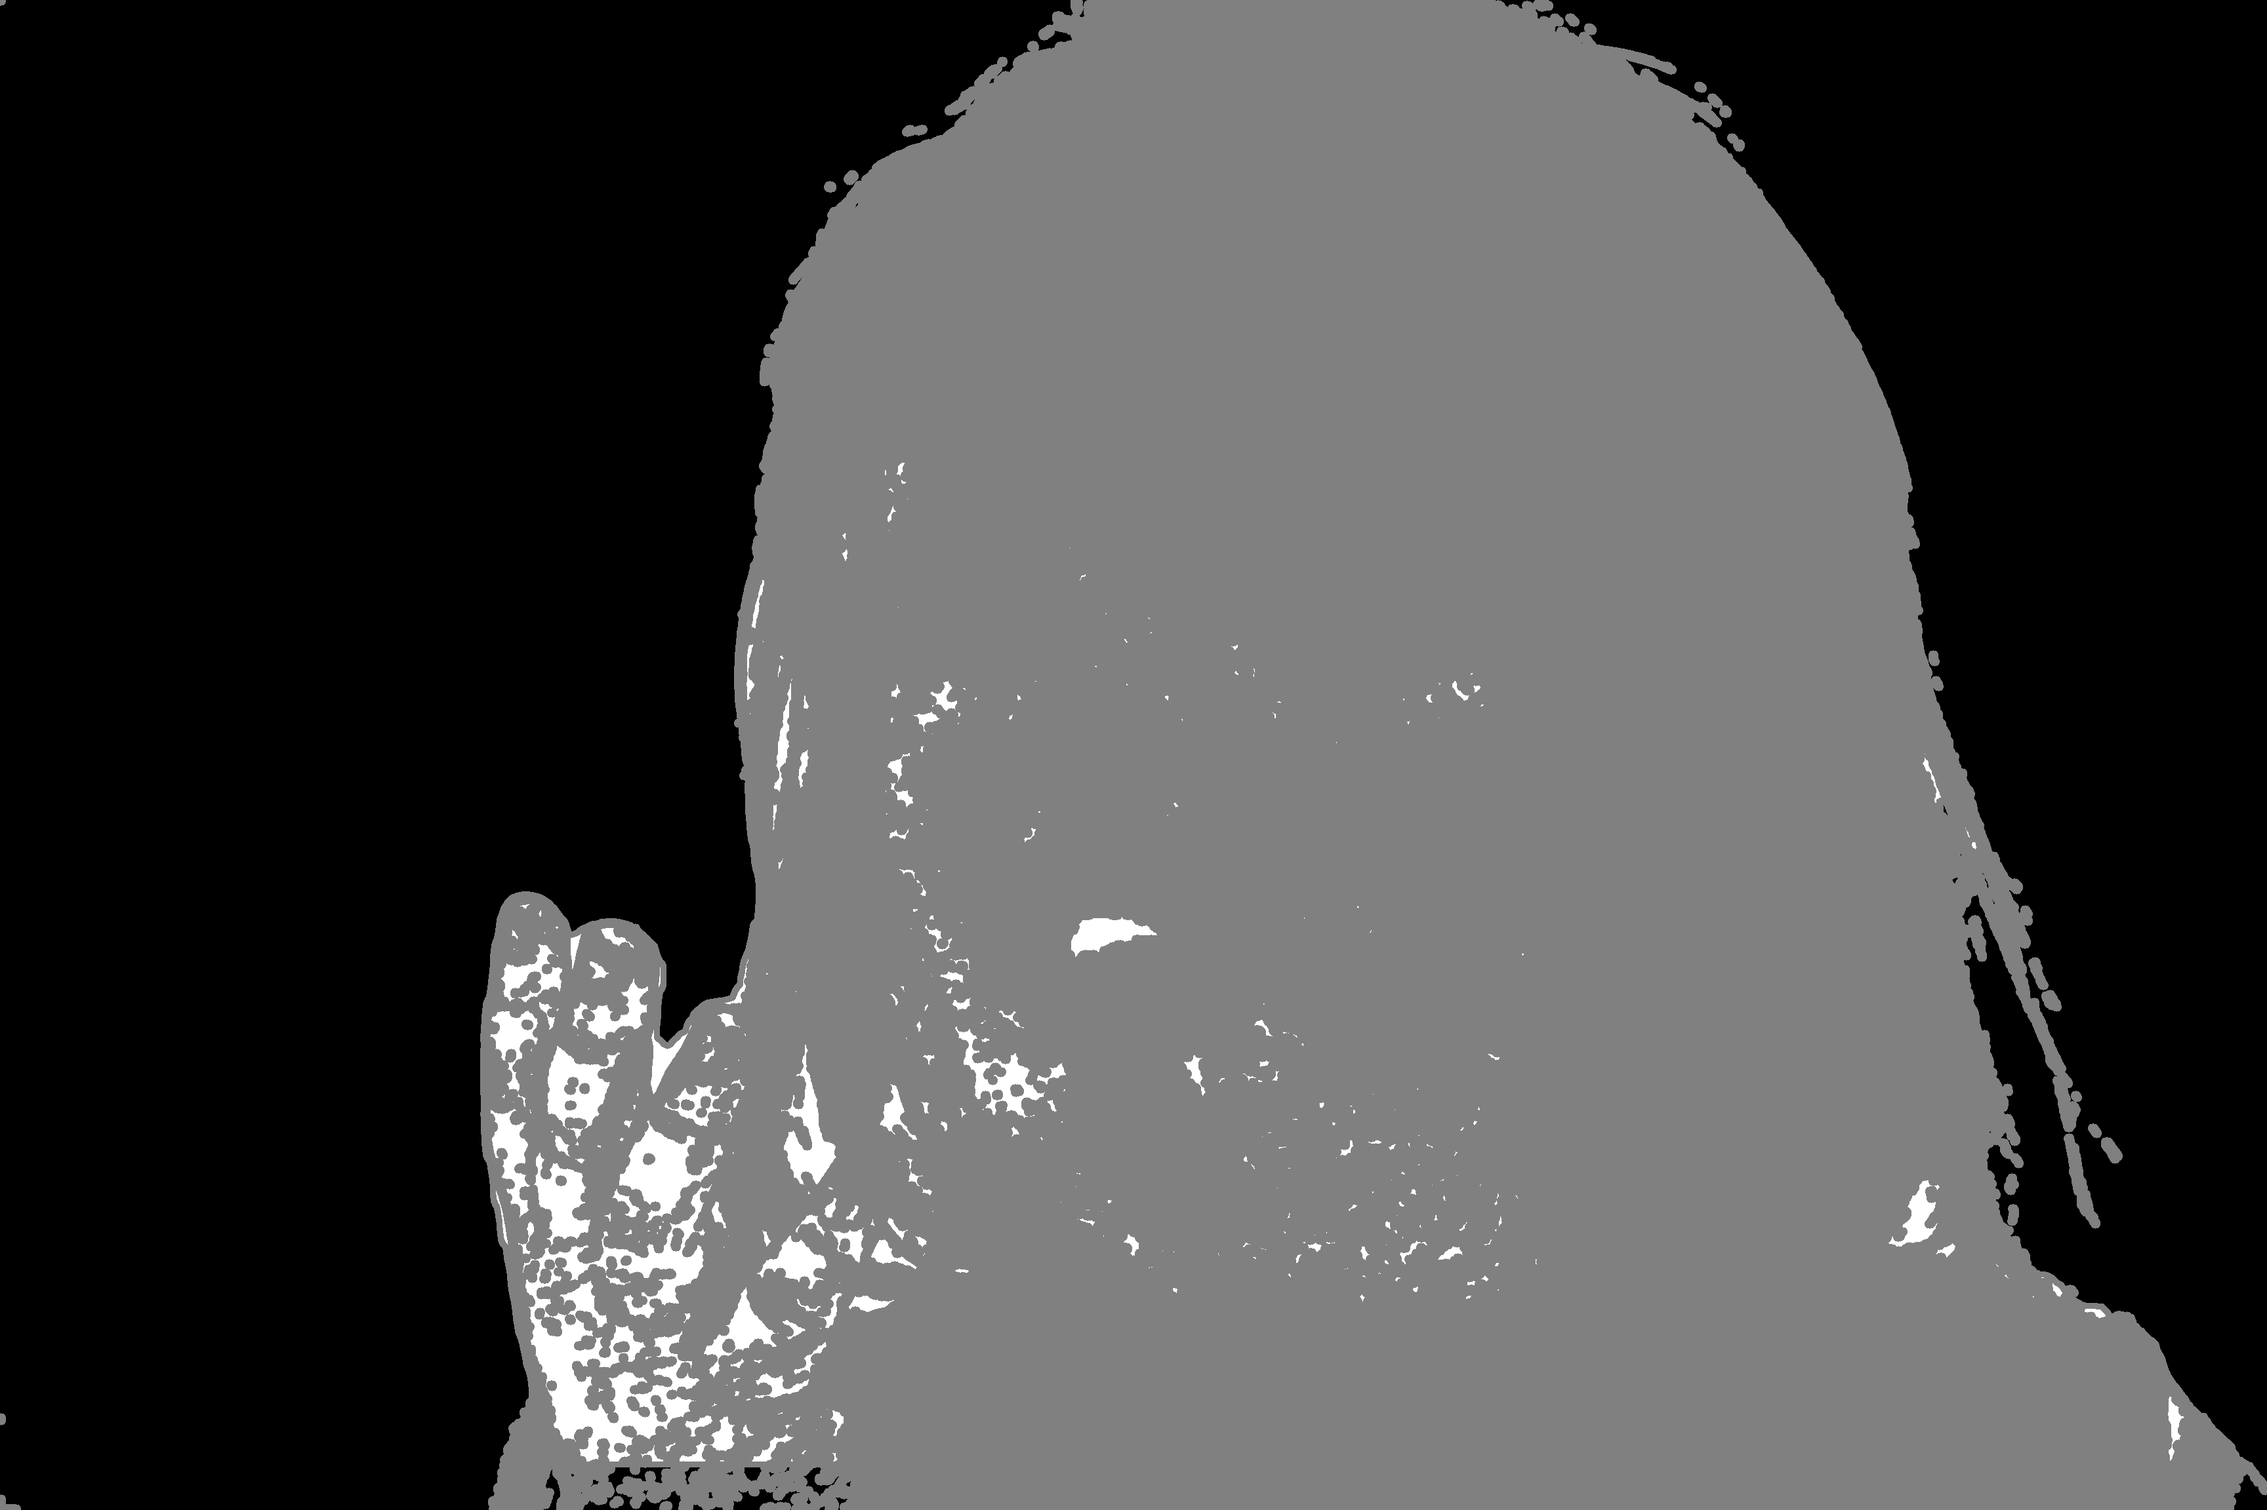
Hair matting
Combining original trimap with image made by Canny
Canny threshold ( min = 20, max = 30 )

Slide 10
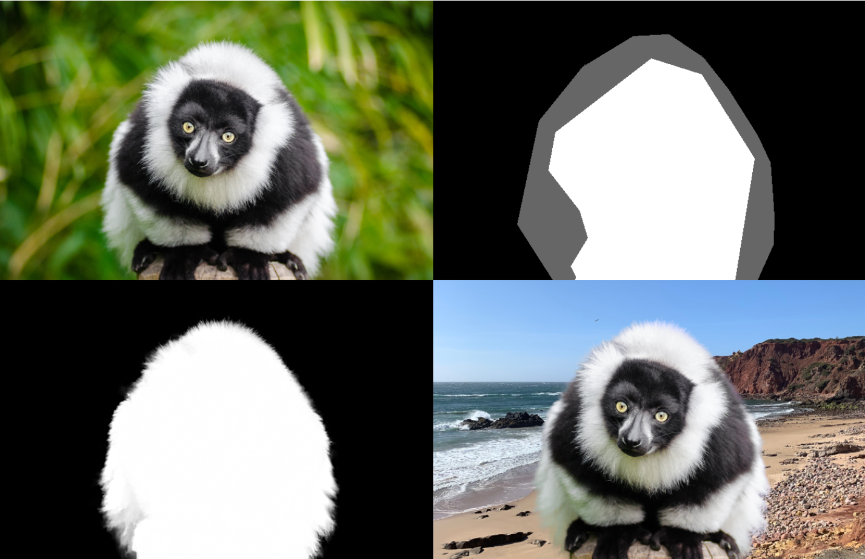
Hair matting

Slide 11
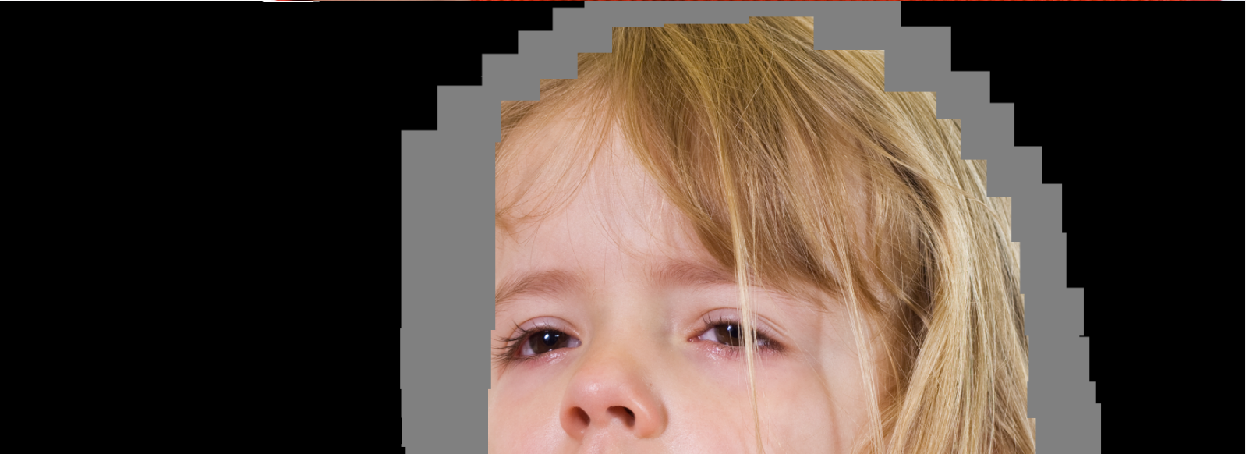
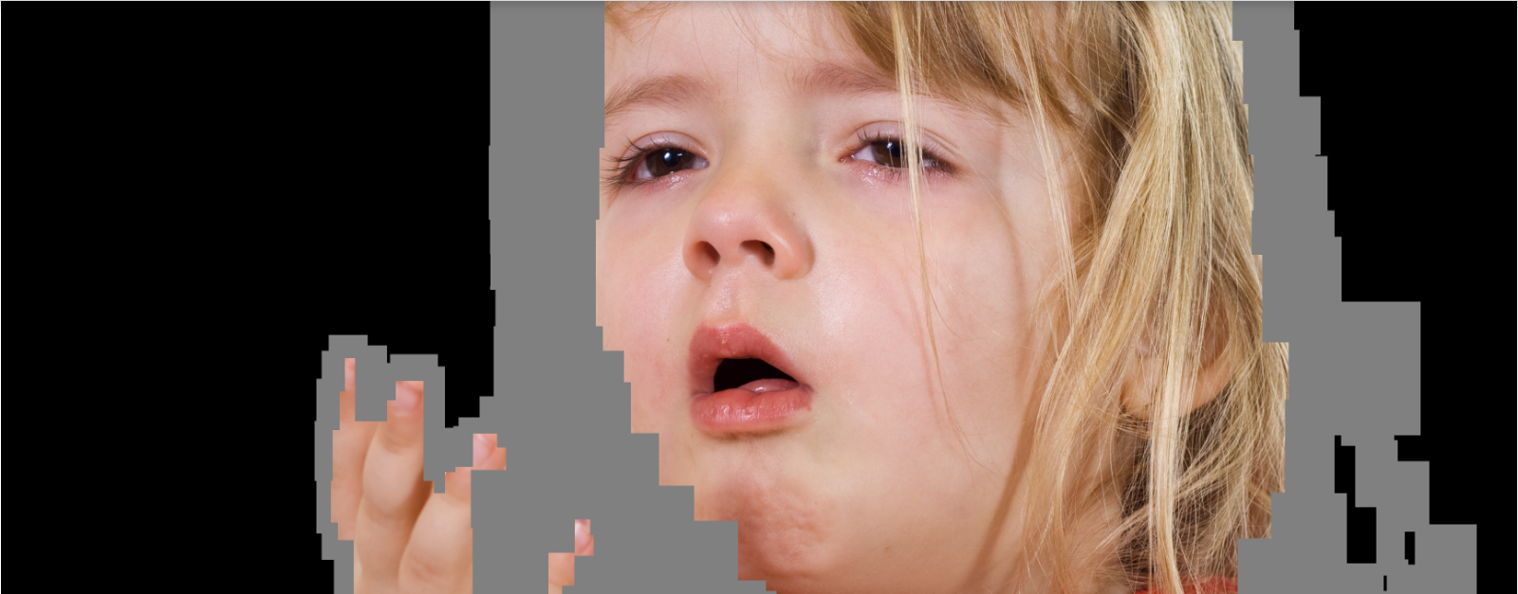
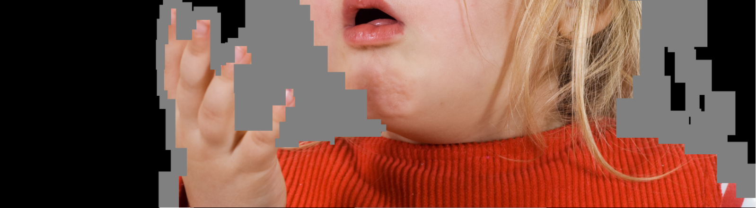
Hair matting

Slide 12
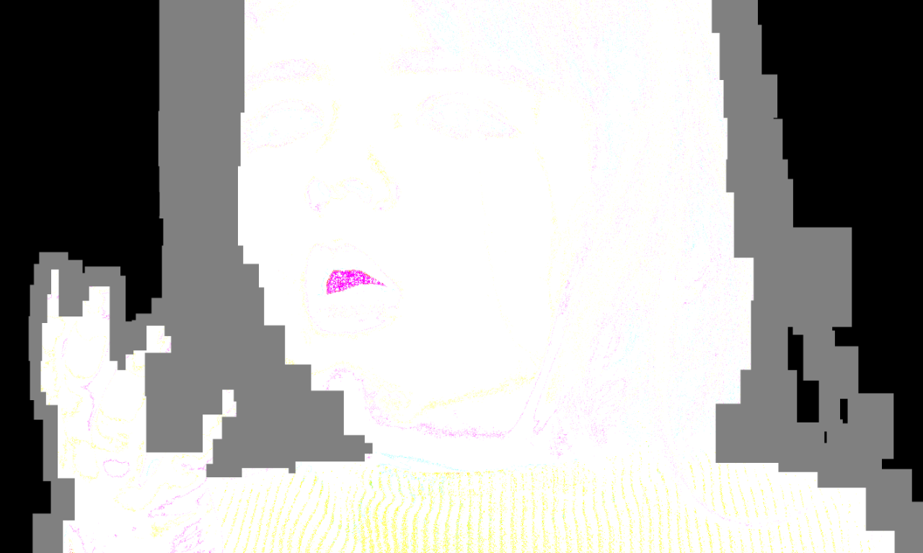
Hair matting
Bug fixing

Slide 13
Hair matting
To do

